Slide 1
CHAPTER 2
INTRODUCING C PROGRAMMING LANGUANGE

Slide 2
Lecture outline
History
Why C
Preparing to Program in C

Slide 3
BRIEF HISTORY
You might be wondering about the origin of the C language and where it got its name. C was created by Dennis Ritchie at the Bell Telephone Laboratories in 1972. The language wasn't created for the fun of it, but for a specific purpose: to design the UNIX operating system (which is used on many computers). From the beginning, C was intended to be useful--to allow busy programmers to get things done.
Because C is such a powerful and flexible language, its use quickly spread beyond Bell Labs. Programmers everywhere began using it to write all sorts of programs. Soon, however, different organizations began utilizing their own versions of C, and subtle differences between implementations started to cause programmers headaches.

Slide 4
In response to this problem, the American National Standards Institute (ANSI) formed a committee in 1983 to establish a standard definition of C, which became known as ANSI Standard C. With few exceptions, every modern C compiler has the ability to adhere to this standard.
Now, what about the name? The C language is so named because its predecessor was called B. The B language was developed by Ken Thompson of Bell Labs. You should be able to guess why it was called B.

Slide 5
WHY C
In today's world of computer programming, there are many high-level languages to choose from, such as C, Pascal, BASIC, and Java. These are all excellent languages suited for most programming tasks. Even so, there are several reasons why many computer professionals feel that C is at the top of the list:
C is a powerful and flexible language. What you can accomplish with C is limited only by your imagination. The language itself places no constraints on you. C is used for projects as diverse as operating systems, word processors, graphics, spreadsheets, and even compilers for other languages etc.
C is a popular language preferred by professional programmers and as a result, a wide variety of C compilers and helpful accessories are available or have been created using C.

Slide 6
C is a portable language. Portable means that a C program written for one computer system or on a given OS or machine (an IBM PC, for example) can be compiled and run on another system (a DEC VAX system, perhaps) with little or no modification. Portability is enhanced by the ANSI standard for C which are the set of rules for C compilers.
C is a language of few words, containing only a handful of terms, called keywords, which serve as the base on which the language's functionality is built. You might think that a language with more keywords (sometimes called reserved words) would be more powerful.
This isn't true. As you program with C, you will find that it can be programmed to do any task.
C is modular. C code can (and should) be written in routines called functions. These functions can be reused in other applications or programs. By passing pieces of information to the functions, you can create useful, reusable code.

Slide 7
PREPARING TO PROGRAM
You should take certain steps when you're solving a problem.
First, you must define the problem. If you don't know what the problem is, you can't find a solution!
Once you know what the problem is, you can devise a plan to fix it.
Once you have a plan, you can usually implement it.
Once the plan is implemented, you must test the results to see whether the problem is solved. This same logic can be applied to many other areas, including programming.
When creating a program in C (or for that matter, a computer program in any language), you should follow a similar sequence of steps:
Determine the objective(s) of the program.
Determine the methods you want to use in writing the program.
Create the program to solve the problem.
Run the program to see the results.

Slide 8
An example of an objective (see step 1) might be to write a word processor or database program. A much simpler objective is to display your name on the screen. If you didn't have an objective, you wouldn't be writing a program, so you already have the first step done.
The second step is to determine the method you want to use to write the program. Do you need a computer program to solve the problem? What information needs to be tracked? What formulas will be used? During this step, you should try to determine what you need to know and in what order the solution should be implemented.
As an example, assume that someone asks you to write a program to determine the area inside a circle. Step 1 is complete, because you know your objective: determine the area inside a circle. Step 2 is to determine what you need to know to ascertain the area.
In this example, assume that the user of the program will provide the radius of the circle. Knowing this, you can apply the formula pr² to obtain the answer.

Slide 9
Now you have the pieces you need, so you can continue to steps 3 and 4, which are called the Program Development Cycle.

Slide 10
PROGRAM DEVELOPMENT CYCLE
The Program Development Cycle has its own steps.
In the first step, you use an editor to create a disk file containing your source code.
In the second step, you compile the source code to create an object file.
In the third step, you link the compiled code to create an executable file.
The fourth step is to run the program to see whether it works as originally planned.

Slide 11
Creating the Source Code Using an Editor
A Programmer uses a text editor to create and modify files containing the C source code. A file containing the source code file is called a source file. Source code is a series of statements or commands that are used to instruct the computer to perform your desired tasks. As mentioned, the first step in the Program Development Cycle is to enter source code into an editor. For example, here is a line of C source code: printf("Hello, Mom!");
This statement instructs the computer to display the message Hello, Mom! on-screen. (For now, don't worry about how this statement works.)
Most compilers come with a built-in editor that can be used to enter source code; however, some do not. Most computer systems include a program that can be used as an editor. If you are using a UNIX system, you can use such editors as emacs, xemacs, vi, pico, kate and many others.
When you save a source file, you must give it a name. The name should describe what the program does. In addition, when you save C program source files, give the file a .C extension. Although you could give your source file any name and extension, .C is recognized as the appropriate extension to use.

Slide 12
Preprocessing
Preprocessing is performed by a program called the preprocessor. It modifies the source code (in memory) according to preprocessor directives (example: #define) embedded in the source code. It also strips comments and unnecessary white spaces from the source code. Preprocessor does not modify the source code stored on disk, every thing is done on the copy loaded into the memory.

Slide 13
Compiling the Source Code
After a C source file has been created, the programmer must invoke the C compiler before the program can be executed. Although you might be able to understand C source code, your computer cannot.
A computer requires digital, or binary, instructions in what is called machine language.
Before your C program can run on a computer, it must be translated from source code to machine language.
This translation is the second step in program development and is performed by a program called a compiler.
The compiler takes your source code file as input and produces a disk file containing the machine

Slide 14
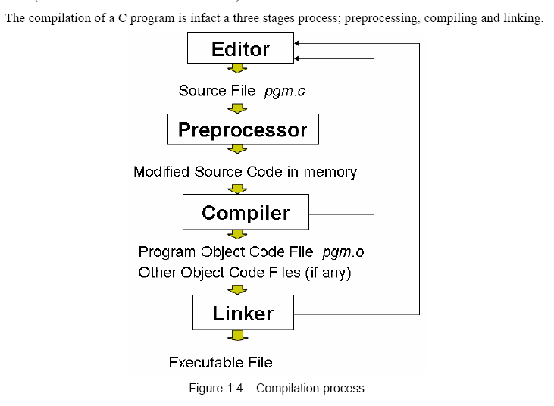

Slide 15
Each compiler needs its own command to be used to create the object code. To compile, you typically use the command to run the compiler followed by the source filename.
For example, suppose you want to compile a C file called myfile.c on a UNIX machine, then you would use the following command;
cc myfile.c
If you are using a graphical development environment, compiling is even simpler. In most graphical environments, you can compile a program listing by selecting the compile icon or selecting something from a menu. Once the code is compiled, selecting the run icon or selecting something from a menu will execute the program. language instructions that correspond to your source code statements.
The machine language instructions created by the compiler are called object code, and the disk file containing them is called an object file.

Slide 16
After you compile, you have an object file. If you look at a list of the files in the directory or folder in which you compiled, you should find a file that has the same name as your source file, but with an .OBJ (rather than a .C) extension. The .OBJ extension is recognized as an object file and is used by the linker. On UNIX systems, the compiler creates object files with an extension of .O instead of .OBJ.
NOTE:
Compilation really happens then on the code produced by the preprocessor. The compiler translates the preprocessor-modified source code into object code (machine code). While doing so it may encounter syntax errors. If errors are found it will be immediately notified to the programmer and compiling will discontinue.
If the compiler finds any non-standard codes or conditions which are suspicious but legitimate it will notify the programmer using warnings and it continues to compile. A well written program should not have any compilation errors or warnings.

Slide 17
Linking to Create an Executable File
One more step is required before you can run your program. Part of the C language is a function library that contains object code (code that has already been compiled) for predefined functions. A predefined function contains C code that has already been written and is supplied in a ready-to-use form with your compiler package.
The printf() function used in the previous example is a library function. These library functions perform frequently needed tasks, such as displaying information on-screen and reading data from disk files. If your program uses any of these functions (and hardly a program exists that doesn't use at least one), the object file produced when your source code was compiled must be combined with object code from the function library to create the final executable program. (Executable means that the program can be run, or executed, on your computer.) This process is called linking, and it's performed by a program called (you guessed it) a linker.

Slide 18
Linking is the final step and it combines the program object code with other object codes to produce the executable file.
The other object codes come from run-time libraries, other libraries, or object files that the programmer has created. Finally it saves the executable code as a file on the disk. If any linker errors are encountered the executable file will not be generated.

Slide 19
Completing the Development Cycle
Once your program is compiled and linked to create an executable file, you can run it by entering its name at the system prompt or just like you would run any other program. If you run the program and receive results different from what you thought you would, you need to go back to the first step.
You must identify what caused the problem and correct it in the source code. When you make a change to the source code, you need to recompile and relink the program to create a corrected version of the executable file. You keep following this cycle until you get the program to execute exactly as you intended.
One final note on compiling and linking: Although compiling and linking are mentioned as two separate steps, many compilers, such as the DOS compilers, do both as one-step. Regardless of the method by which compiling and linking are accomplished, understand that these two processes, even when done with one command, are two separate actions.

Slide 20
Next Lecture
Writing our first Programs in C
Installing the editor
Start working with the editor
END

